Slide 1
PRINCEPLE of
REFRIGERATE
DAIKIN
How is air cooled ?

Slide 2
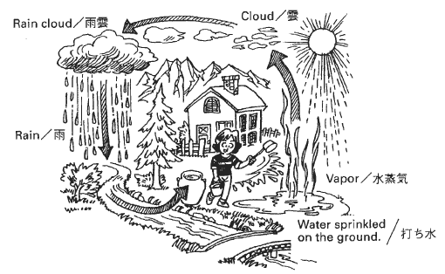
Water sprinkled on the ground serves ----ultimately as an natural cooling machine.
DAIKIN
* Liquid ⇒ Gas by evaporating
* Cool is felt.(Heat is absorbed)
CONDENSER
＊ Gas ⇒ Liquid by cooling
＊ The air temperature ---in sky raises.
(Absorbed Heat is discharged)
EVAPORATOR

Slide 3

DEFINITION
‘Refrigeration’…
…is the transfer of heat from a place where it is ‘not wanted’…
… to a place where it is ‘unobjectionable’. (outside)

Slide 4
HEAT REMOVAL
If heat is removed from inside the container ‘faster’ than it enters...
…The internal temperature becomes colder.

Slide 5
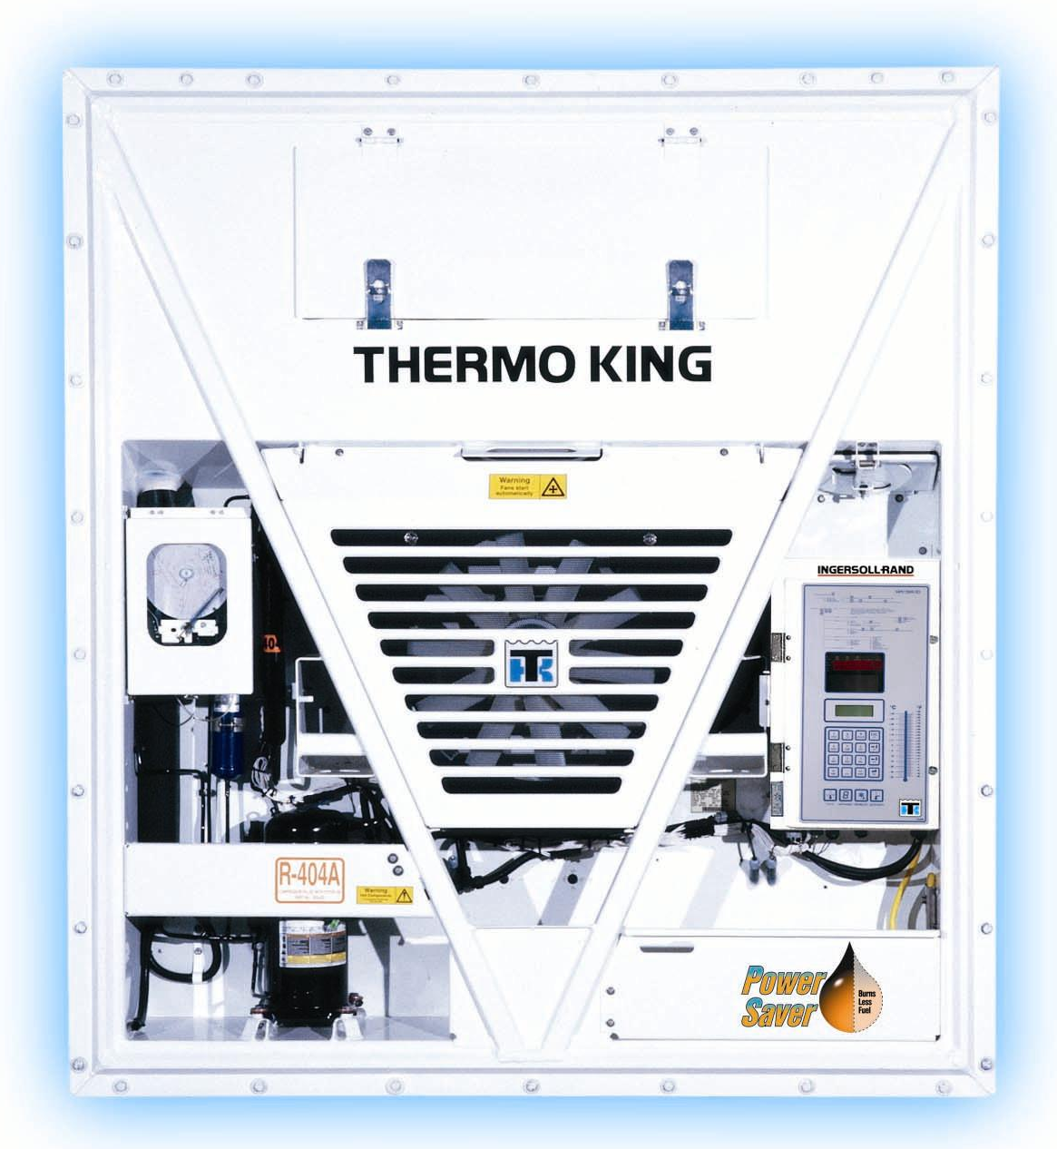
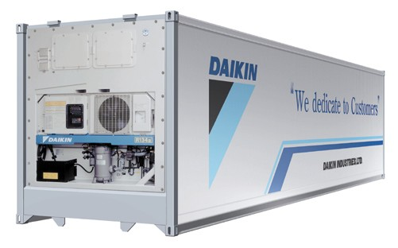
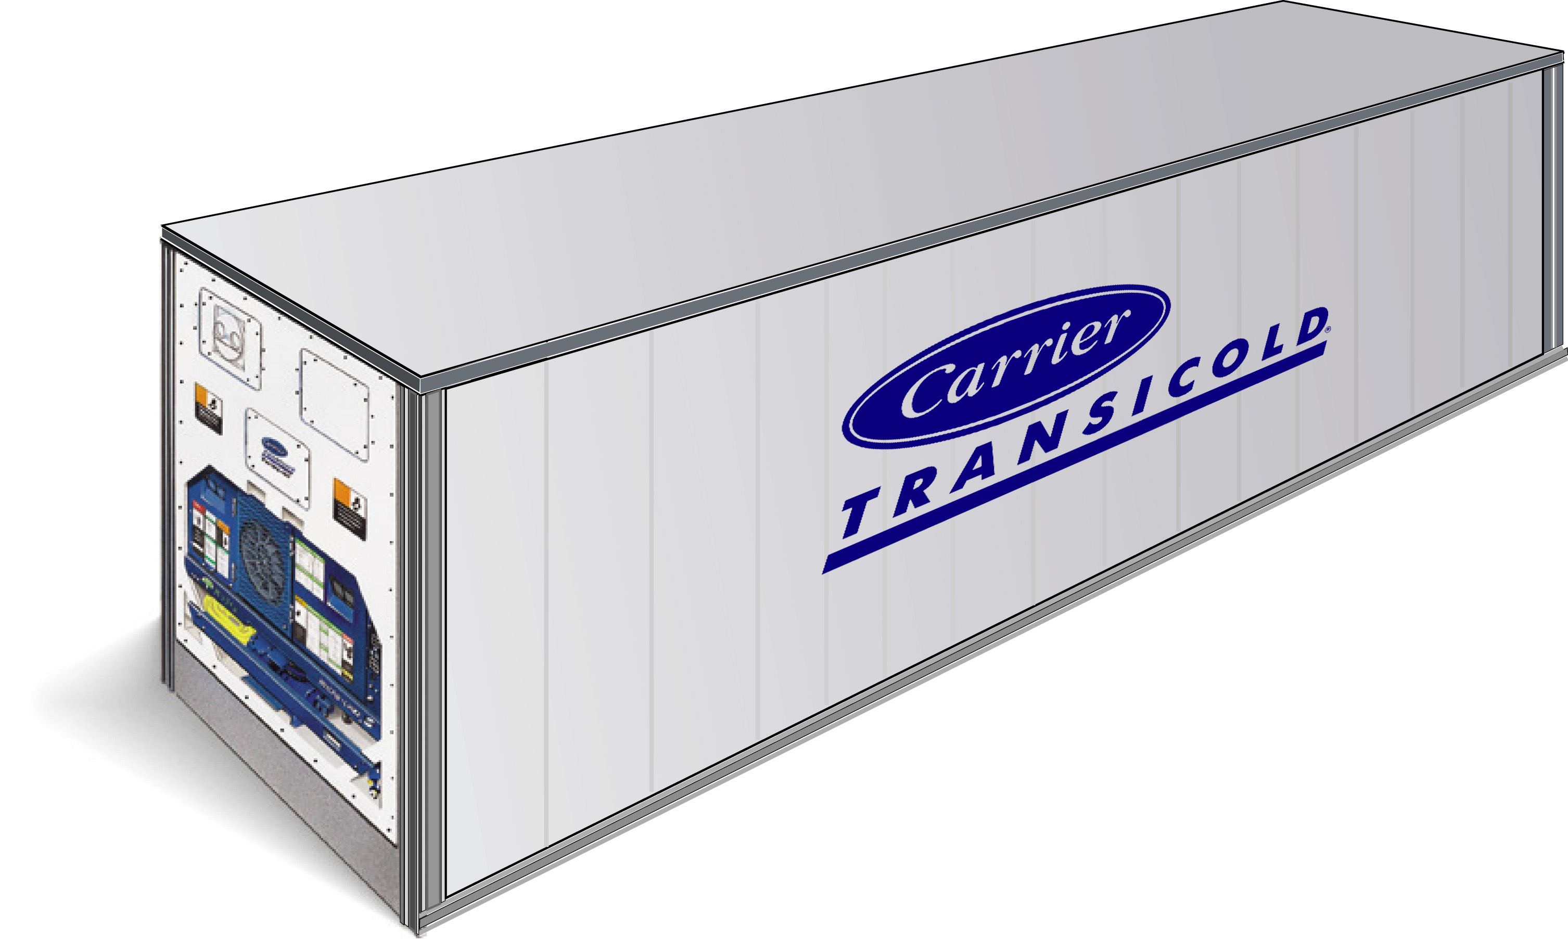
WHAT ARE REEFERS?
Machines that ‘Move Heat’

Slide 6
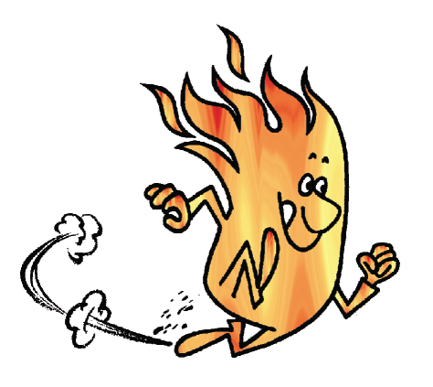


‘HOW’ DOES HEAT MOVE?
Warmer ⇒ Colder - ALWAYS!!!!!!!
‘Faster’ with Large Temp. Difference
Heat
Heat
Heat

Slide 7
‘HOW’ DOES IT MOVE?
Heat can move three (3) ways….
  1. Conduction
  2. Convection
  3. Radiation
Notes:
NEXT: Heat can move by any of these three methods.
NEXT: Conduction
NEXT: Radiation
NEXT: Convection
There are only these three ways heat can move. We will discuss each one individually.
NEXT

Slide 8

CONDUCTION
Heat moves through Solids & Liquids

Slide 9
CONDUCTION

Slide 10
CONVECTION
Definition - Heat transfers via the circulation (movement) of a fluid. i.e…..
  Air is a fluid
  Refrigerant Liquid & Vapor are fluids
Types
  ‘Natural’ Convection
  ‘Forced’ Convection
Notes:
Convection is the third method of heat transfer.
NEXT: Heat moves with a fluid as it circulates.
Circulation can be created by some kind of a pump or occur naturally.
NEXT: Air is considered to be a fluid, it is just thinner.
NEXT: Liquid and vapor refrigerant is considered a fluid.
NEXT

Slide 11
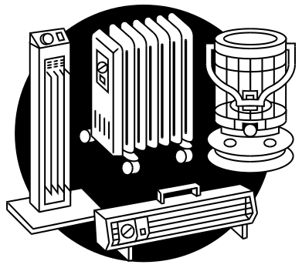
‘NATURAL’ CONVECTION
Warm Air Rises
Heater
Cool Air Falls

Slide 12
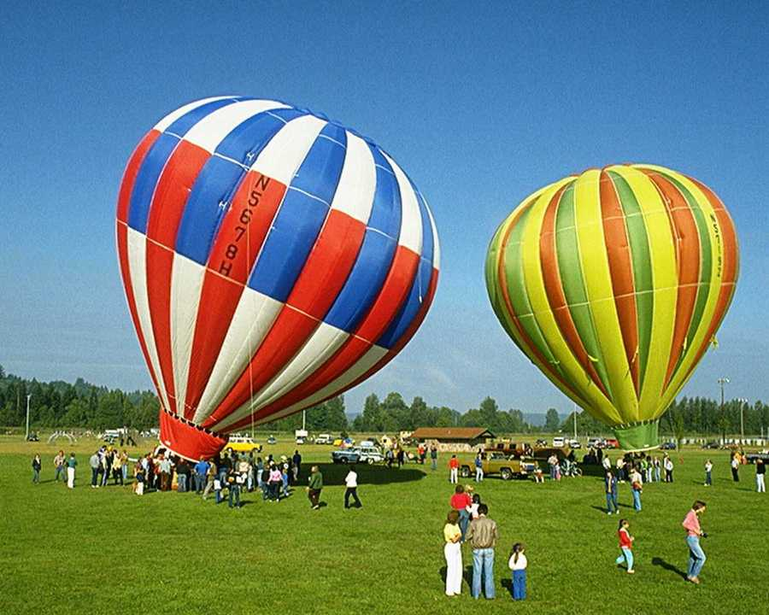
‘NATURAL’ CONVECTION

Slide 13
‘FORCED’ CONVECTION

Slide 14
RADIATION
Raises temperature of the substance that absorbs it
Dark colors absorb ‘more’ heat…
Light colors absorb ‘less’ heat
Notes:
The next type of heat transfer is Radiation.
NEXT: It does not raise the temperature of the air as it passes through.
NEXT: Only when it strikes something and is absorbed does the temperature go up.
NEXT: The darker a color is the more radiant heat it will absorb. The lighter a color is the less radiant heat it will absorb.
NEXT: Radiant heat moves in straight lines like light.
What are other examples of Radiant heat? (sun)
Why does your car interior get so hot when it is out in the sun? Radiant heat will pass through clear glass. It warms the seats and is then trapped.
NEXT

Slide 15
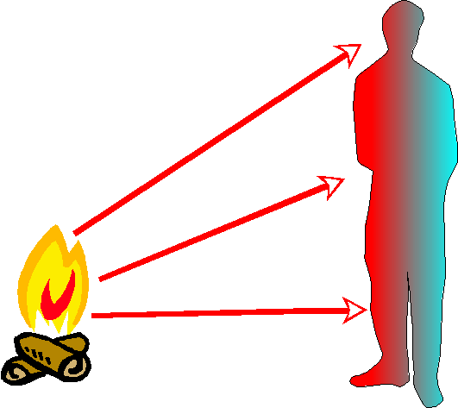
RADIATION

Slide 16
RADIATION

Slide 17
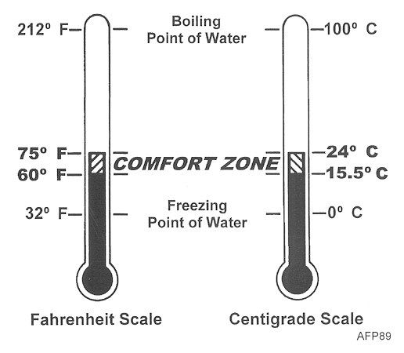
TEMPERATURE
Is measured in degrees
Fahrenheit or Centigrade

Slide 18
TEMPERATURE
The temperature inside the controlled space (container) is called….
The temperature surrounding the
Container is called…
AMBIENT
Box Temperature
AMBIENT
AMBIENT
AMBIENT

Slide 19
TERMS TO REMEMBER
Temperature
Box Temperature
Ambient Temperature

Slide 20
Questions?

